Slide 1

QUANTIFYING VEGETATION RECOVERY ON SANTA ROSA ISLAND
Elizabeth Rentschlar

Slide 2
Introduction
Impact of a hurricane depends on the height and extent of dunes
Dune development is dependent on vegetation recovery since last storm
Island resiliency depends on the re-establishment of vegetation and the rate of regrowth
Vegetation recovery rates are not well understood in barrier island environments

Slide 3
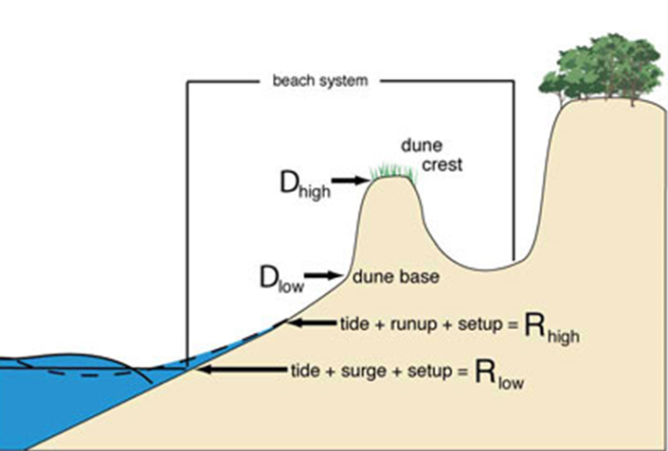
Storm Response
Collision Regime
Scarping of beach and dune
Transfers sand offshore
Burial or removal of the vegetation
Overwash and breaching of dune
Transfers sand to the back barrier
Burial and loss of vegetation

Slide 4
Vegetation Recovery
Recovery Mechanisms:
Reemergence of buried plants
Roots and Rhizomes
Seed banks
Colonization from other parts of the island
Previous Studies of barrier island vegetation recovery
Miller et al. (2010)
Used vegetation census, happened to have a hurricane during the study period
Snyder and Boss (2002)
Proxy island used to measure pre-storm vegetation

Slide 5
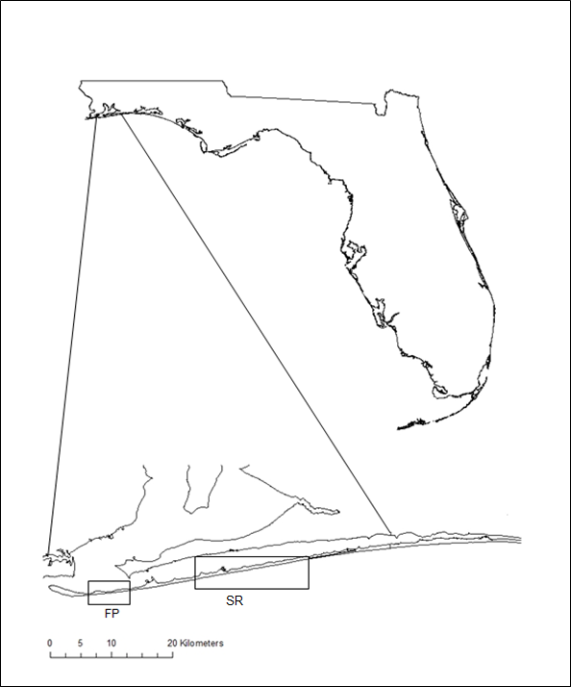
Santa Rosa Island
Located in the Florida panhandle
Hurricane Opal (4) – 10/1995
Hurricane Danny (1) – 07/1997
Hurricane Georges (4) – 09/1998
Hurricane Ivan (5) – 09/2004
Hurricane Dennis (4) – 07/2005

Slide 6
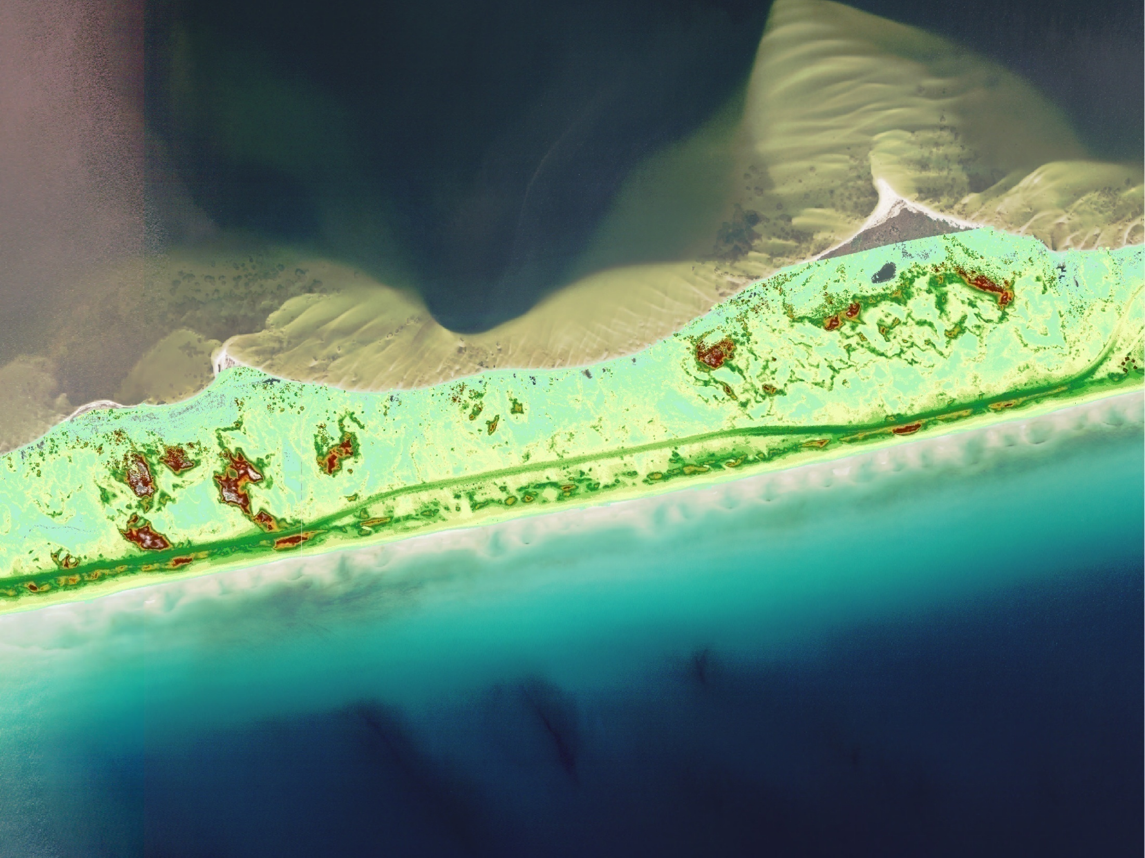
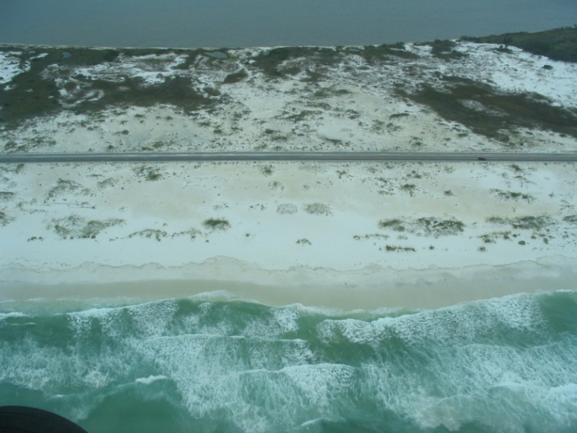
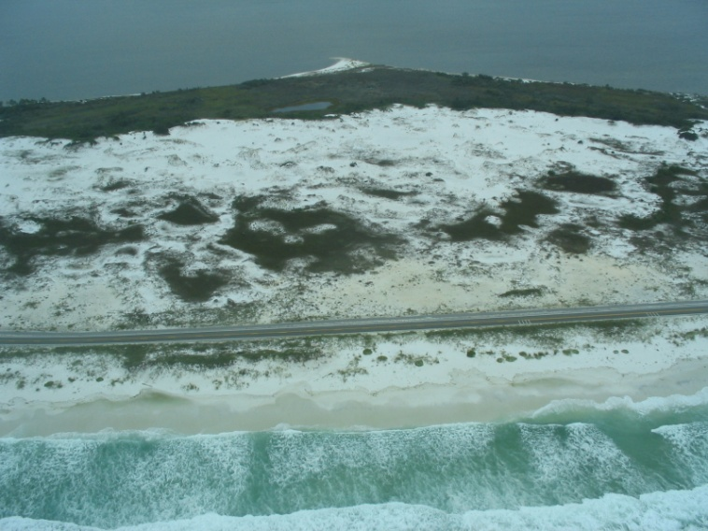
Pre-Ivan (May 2004)
Collision-Overwash
Overwash-Breaching
Collision-Overwash

Slide 7

Research Questions
What is the rate of dune vegetation recovery?
How does it vary spatially along the island?

Slide 8
Methodology
Run ISODATA Classification on 1994, 1997, 1999, 2000, 2004, 2005, 2007, and 2010 images
Perform accuracy assessments
Convert rasters into polygons
Measure area of sand, trees, and non tree vegetation in each transect
Model Vegetation Change with the Verhulst Model
Perform Spectral analysis to determine frequency of repeated vegetation growth patterns

Slide 9
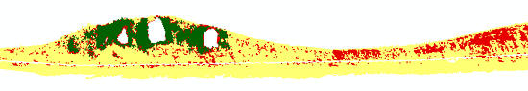
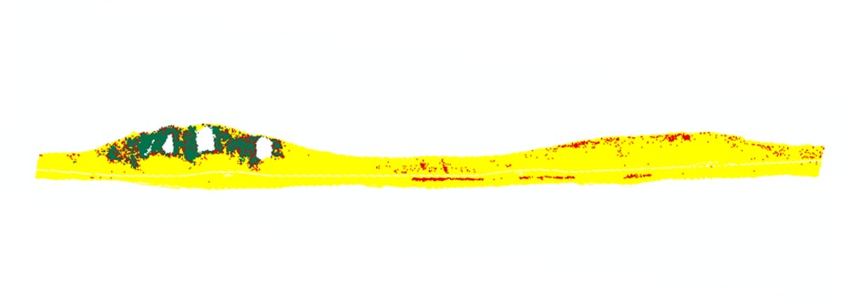
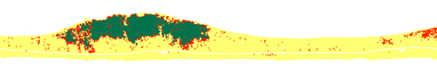
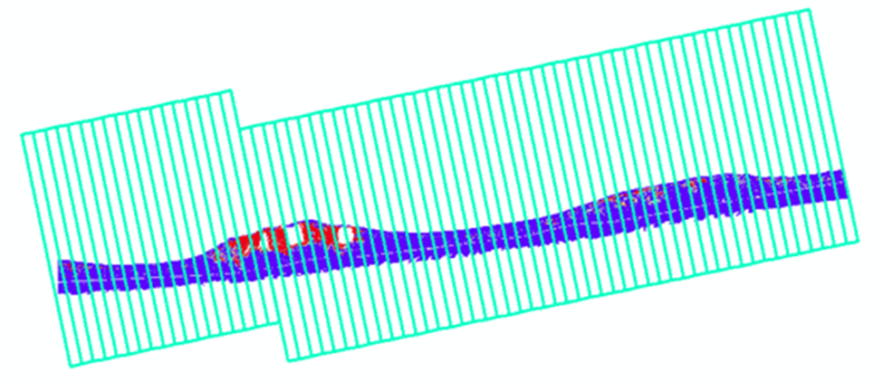
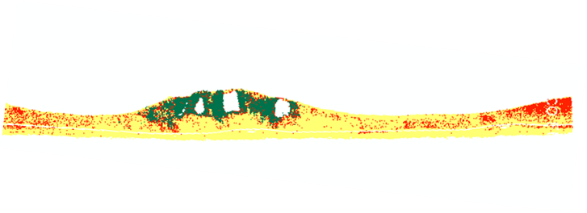
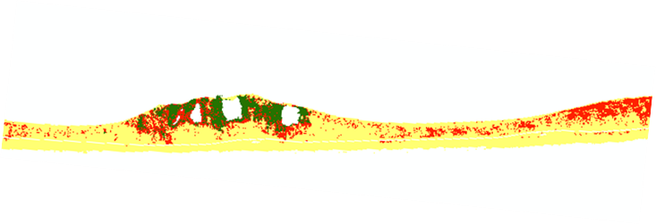
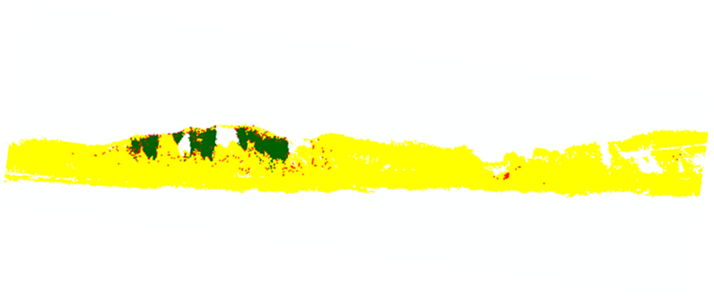
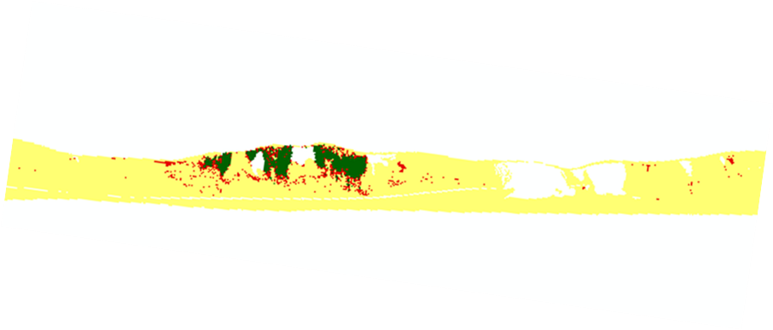
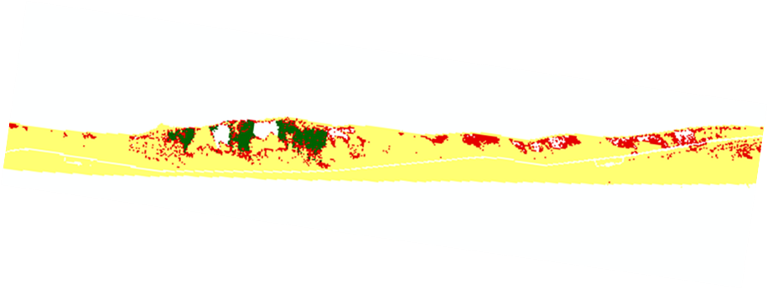
Methodology: Classification and Segmentation
1994
1997
1999
2000
2004
2005
2007
Transects are each 100m wide and 2km long.
Polyline → COGO tool
2010
Notes:
2004: Veg omission 42% (Sand commission of 30%)
2007: Veg omission 31% (Sand commission of 19% and Tree Commission of 8%)

Slide 10
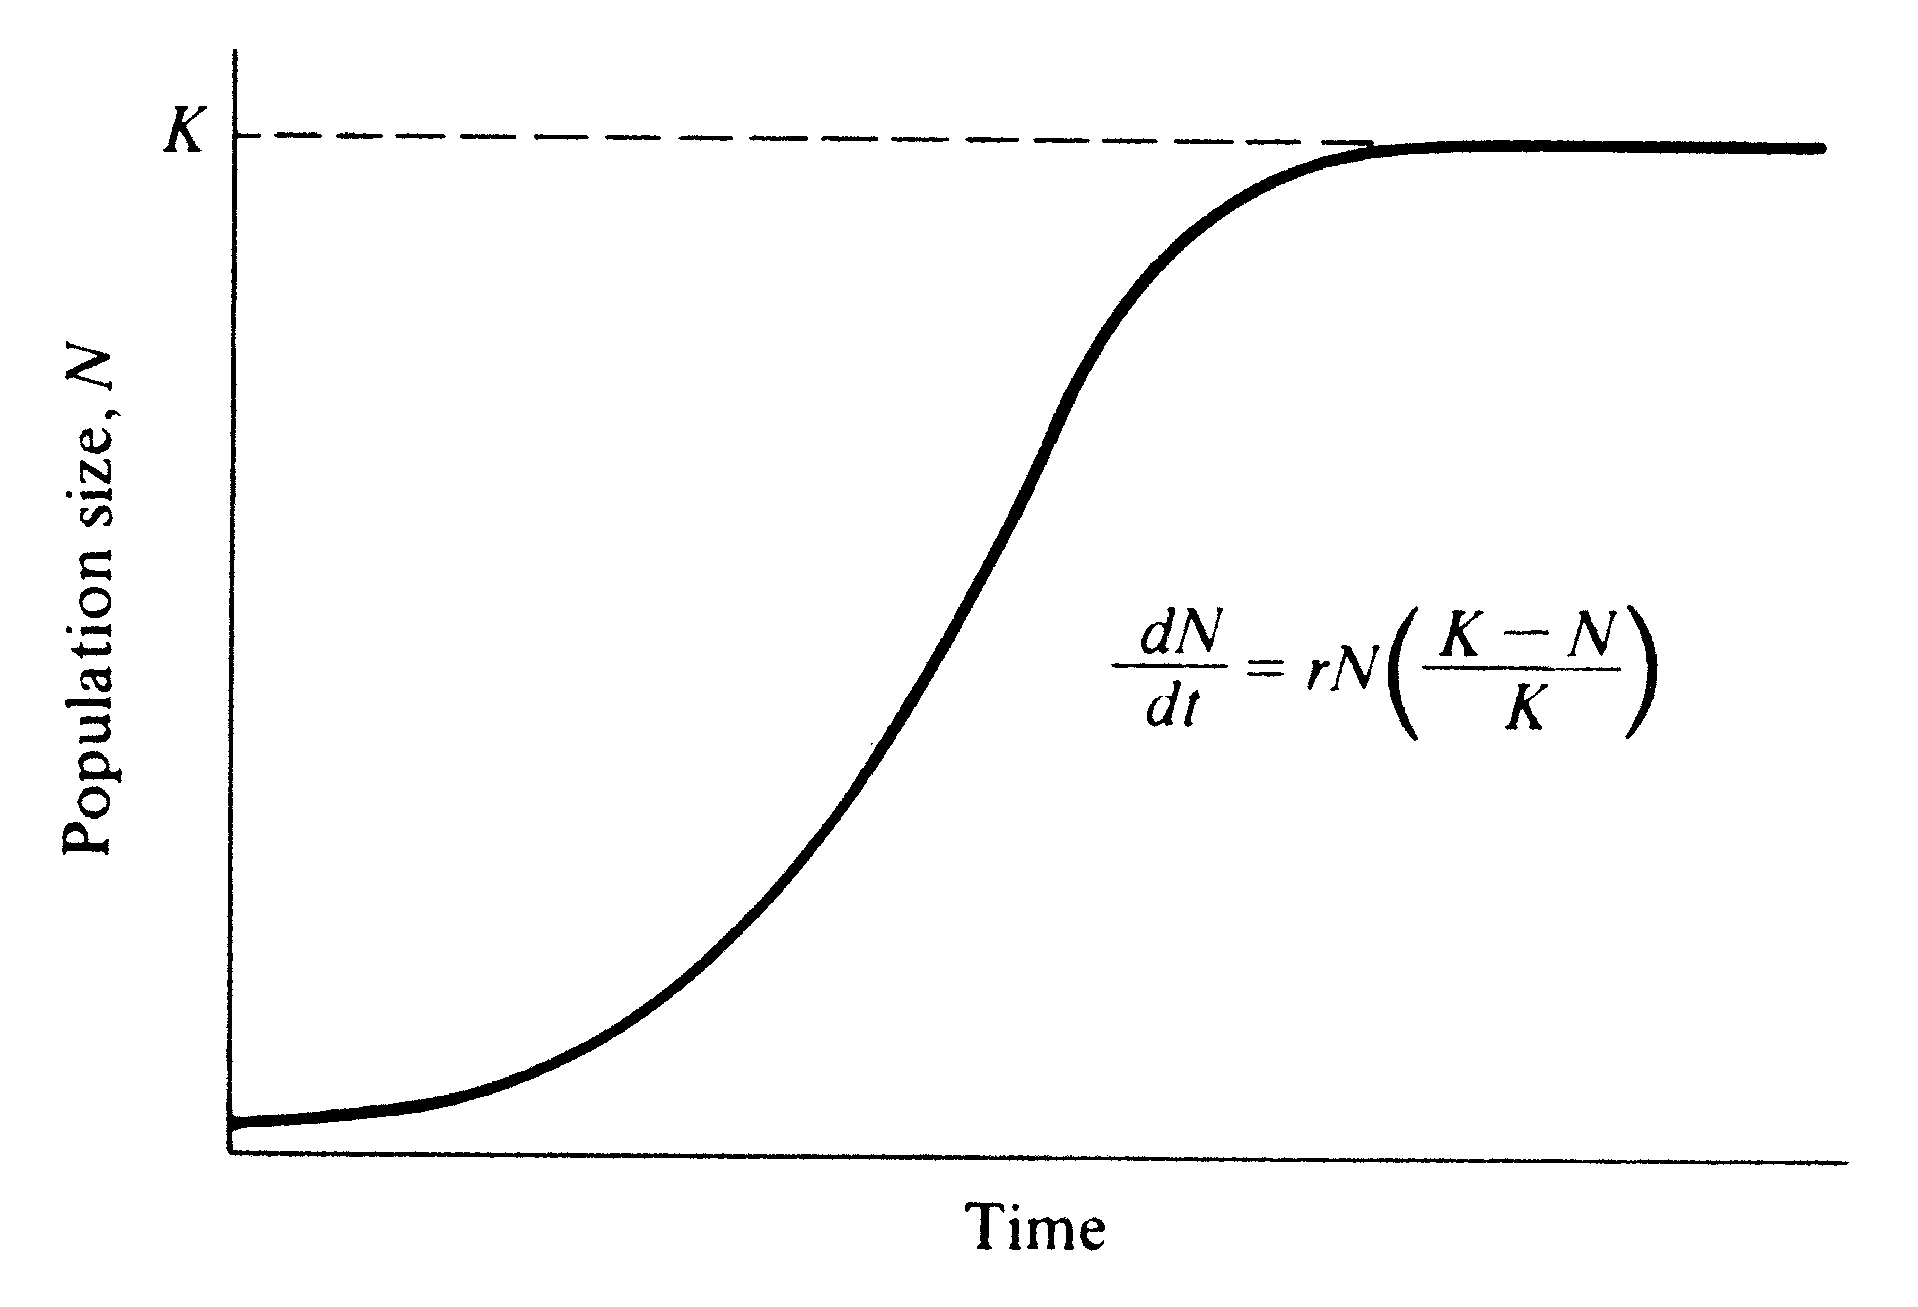
Verhulst Model (1838)
r: population growth rate
N: time 0
K: area that is available for plant growth
pre-storm vegetation
different percentages of the land mass

Slide 11
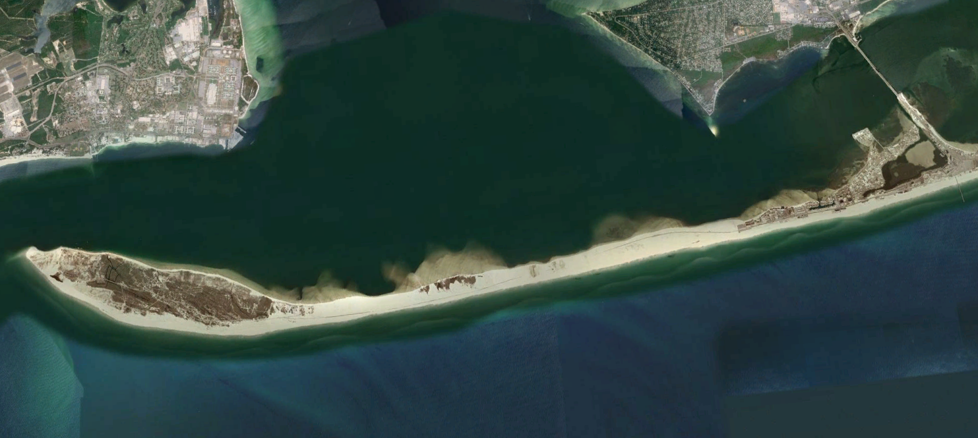
Fort Pickens

Slide 12
Average Vegetation Area FP

Slide 13
Average Vegetation Area FP
Time 0

Slide 14
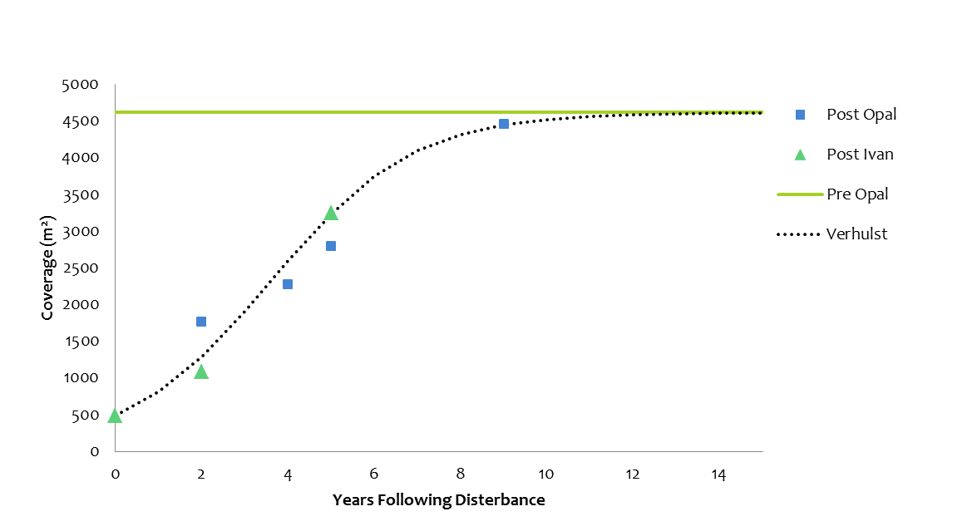
Average Vegetation Recovery FP
p < 0.01
K = Pre Opal
(r) = 0.6

Slide 15
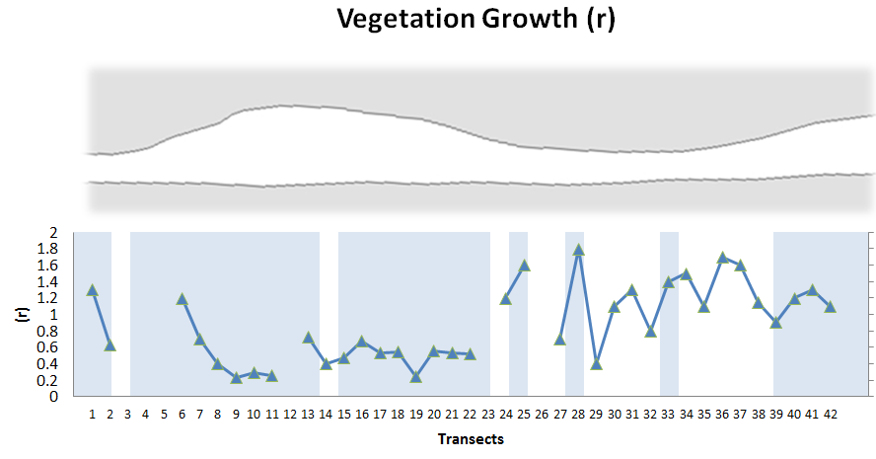
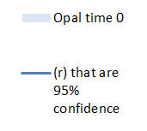
Spatial Distribution of Vegetation Growth Rate FP

Slide 16
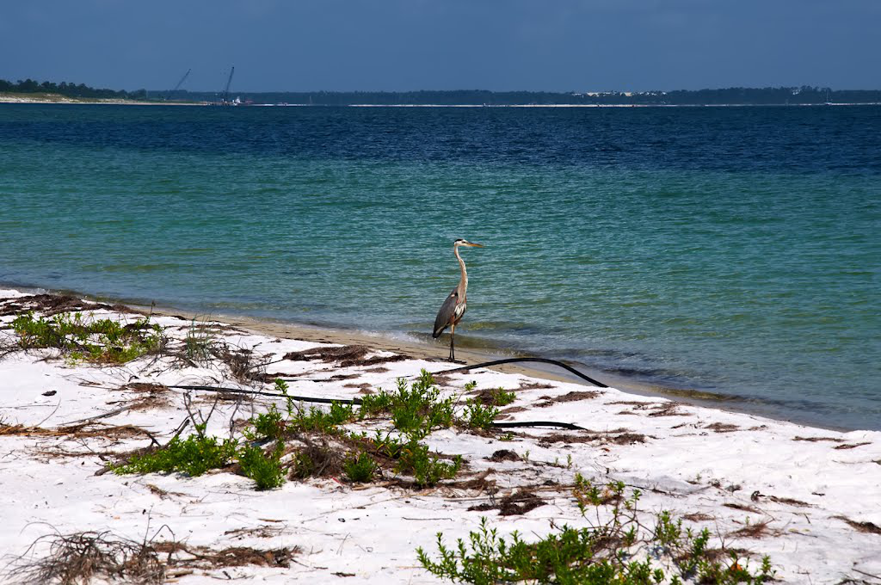
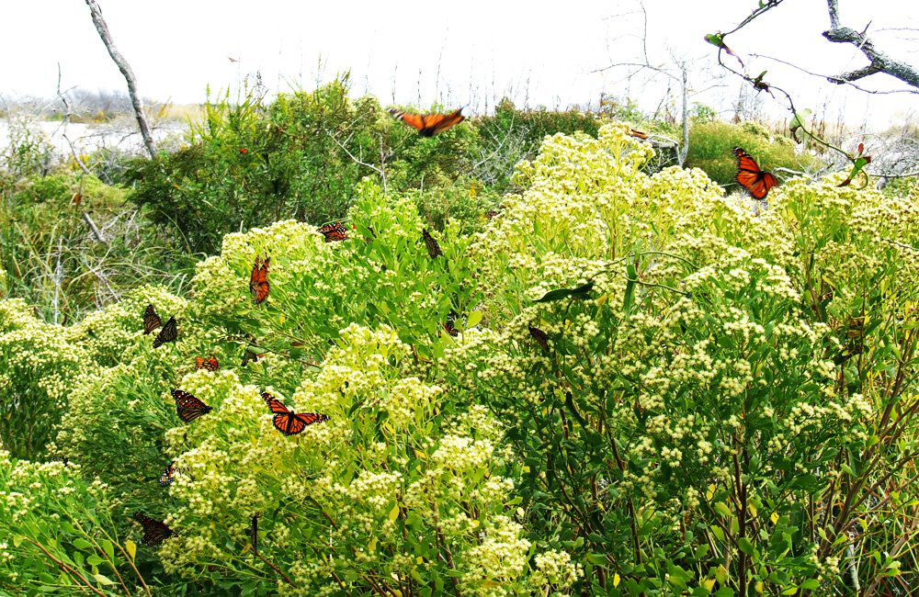
Spatial Distribution of Vegetation Growth Rate FP

Slide 17
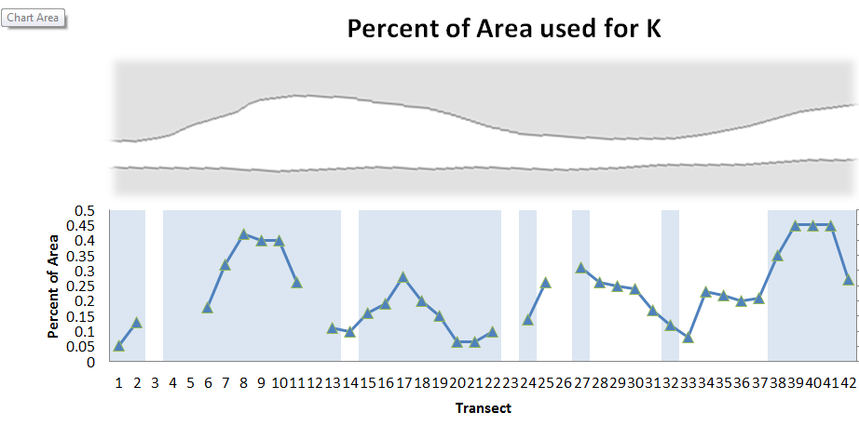
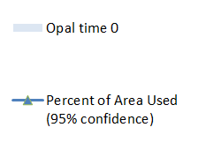
Spatial Distribution of K at FP

Slide 18
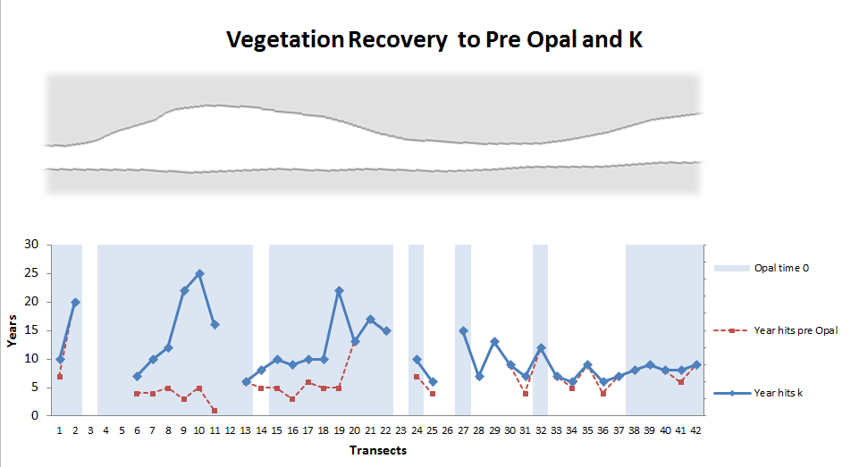
Recovery time along FP

Slide 19
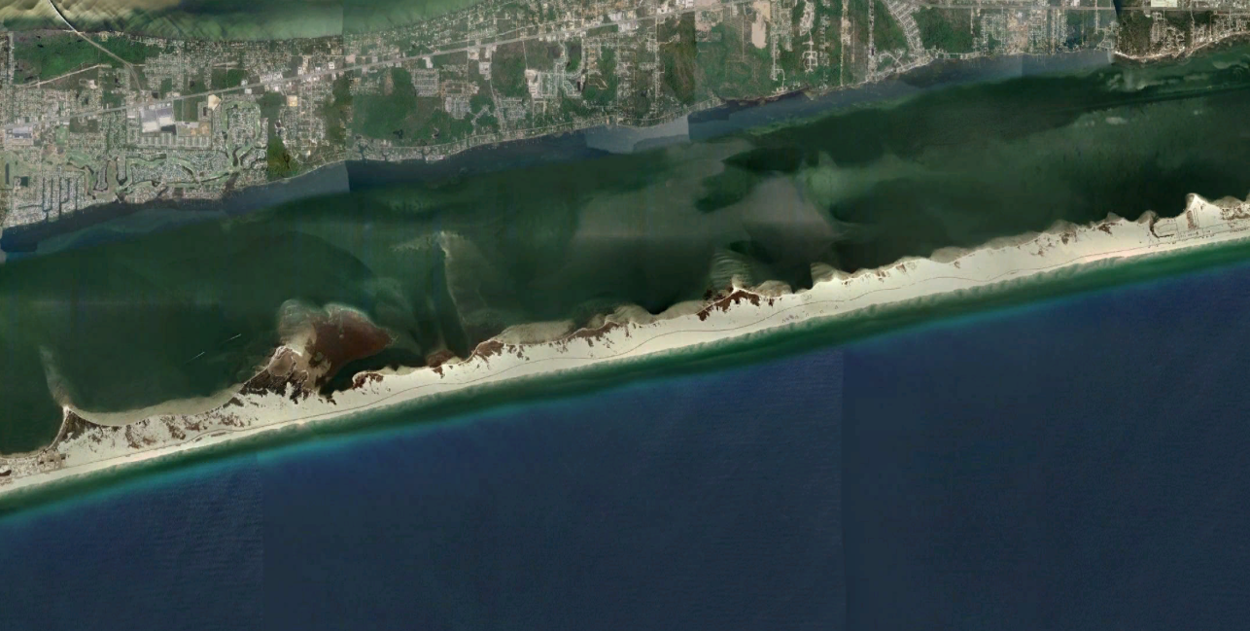
Santa Rosa

Slide 20
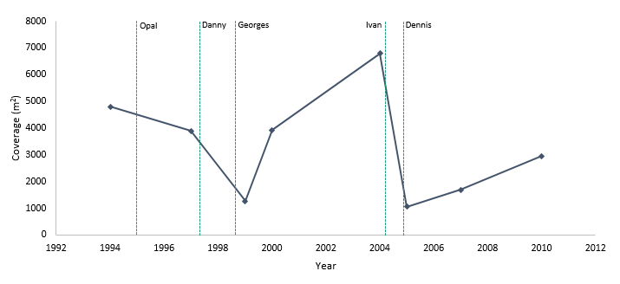
Average Vegetation Area SR

Slide 21
Average Vegetation Area SR
Time 0
?

Slide 22
Average Vegetation Recovery SR Opal as N₀ vs Georges as N₀
Opal
p < 0.02
K = 30% area
(r) = 0.3
Georges
p < 0.05
K = 20% area
(r) = 0.45
Notes:
The SR study area is made up of 154 transects. Of these transects 79 are significant fits and 75 are insignificant. There is a very strong relationship with the significance of the individual transects fit to the vegetation recovery model and which 53 end of the study area is being examined. There is only one significant transects in the first 37 transects on the west end of the study area.

Slide 23
Santa Rosa 37-155

Slide 24
Average Vegetation Area SR 37-153

Slide 25
Average Vegetation Area SR 37-153
Time 0

Slide 26
Average Vegetation Recovery SR
p < 0.01
K = 41% area
(r) = 0.32

Slide 27
Spatial Distribution of Vegetation Growth Rate SR

Slide 28
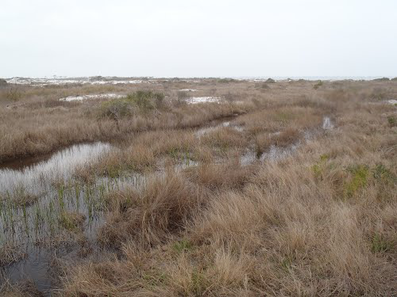
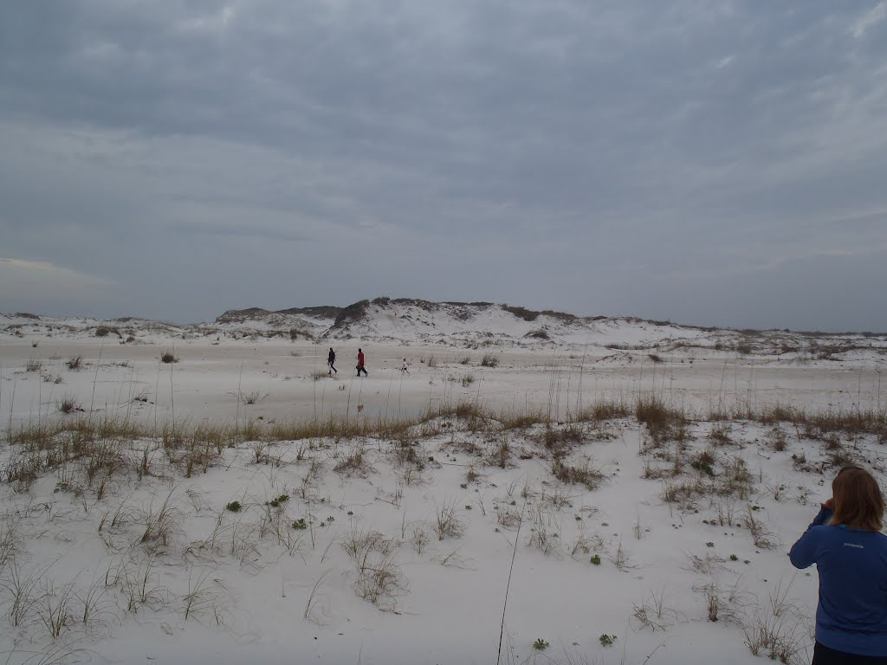
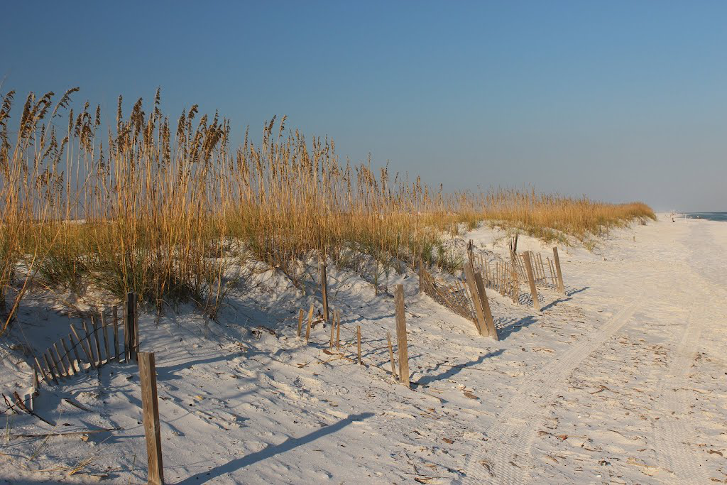
Spatial Distribution of Vegetation Growth Rate SR

Slide 29
Spatial Distribution of K at SR

Slide 30
Recovery time along SR

Slide 31
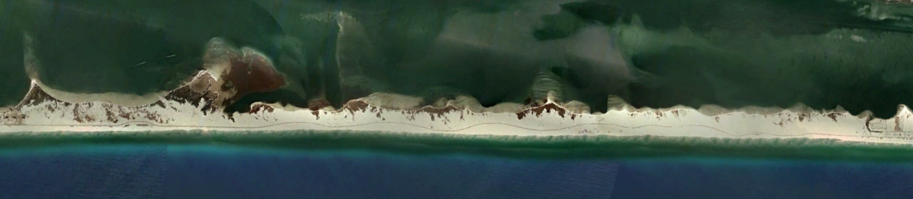
Fourier Transformation

Slide 32
Fourier Transformation

Slide 33
Fourier Transformation

Slide 34
Fourier Transformation

Slide 35
Changing Storm Frequencies
FP
SR

Slide 36
Changing Storm Magnitudes

Slide 37
Response and Recovery
Notes:
When simplistically envisioned the recovery rate of vegetation following minor storms will be fastest in the headlands that’s are geomorphicly dominated by a collision regime and slightly slower in the washover fans. Following medium storms the amount of time needed for recovery between the geomorphic regimes will be similar because the growth rate of the vegetation on the overwashed areas is higher and the vegetation on the collision regime portions of the island have greater vegetation survival. Following large storms recovery will be fastest in the overwashed areas because the vegetation spreads quickly and the area has a lower carrying capacity, where the vegetation in the headlands has a lower growth rate and has a larger area to repopulate. The dotted line represents what the vegetation recovery becomes when a second storm hits before the vegetation has a chance to recover to K.

Slide 39

Future Directions
Does the recovery occur in the same location and the same rate or is there an offset between vegetation and dune recovery?
Use LiDAR data to determine the location of dunes and recovery of dunes

Slide 40
QUANTIFYING VEGETATION RECOVERY ON SANTA ROSA ISLAND
Elizabeth Rentschlar

Slide 41
Accuracy Assessments
 | FP
 | Overall | Kappa | Veg
1994 | 99.05 | 0.99 | 100.00
1997 | 95.22 | 0.95 | 88.75
1999 | 98.10 | 0.98 | 97.50
2000 | 91.43 | 0.91 | 83.75
2004 | 94.76 | 0.94 | 92.50
2005 | 93.33 | 0.93 | 82.00
2007 | 91.43 | 0.90 | 77.50
2010 | 91.87 | 0.91 | 81.25

Slide 42
Imagery Specs
Year | Source | Type | Resolution
1994, Jan 31 | USGS/NAPP | DOQ- 3.75-MIN CIR | 1-meter
Opal October 4 1995
1997, Feb 15 | FDOT | B/W | 0.33-meter
Danny July 19 1997 Georges September 28 1998
1999, Nov 27 | USGS /NAPP | DOQ- 3.75-MIN CIR | 1-meter
2000, Feb 15 | FDOT | B/W | 0.33-meter
2004, Jan | NAIP | DOQQ- CIR and visible | 1-meter
Ivan September 16 2004 Dennis July10 2005
2005, July | NOAA | Aerial | 0.33-meter
2007, Jan 9 | NAIP | DOQQ- | 1-meter
2010, Jan 10 | NAIP | DOQQ- | 1-meter

Slide 43
If Danny and Georges were not removed

Slide 44
K not Pre Opal or Ivan
37 to 153 SR
p < 0.02
K = Pre Opal Vegetation
(r) = 0.51
37 to 153 SR
p < 0.01
K = Pre Ivan Vegetation
(r) = 0.38

Slide 45
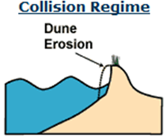
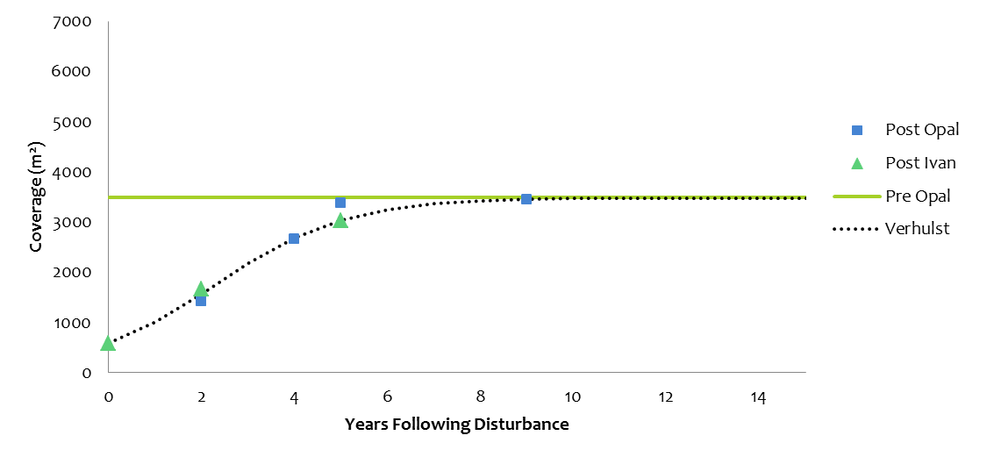
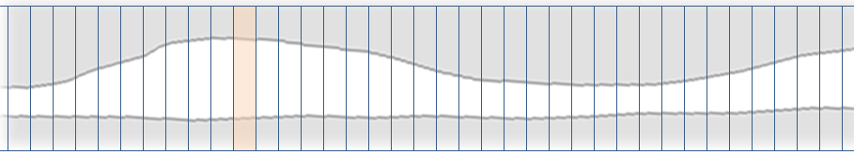
Collision
r² = 0.97
(r) = 0.7
K = 11% of Available Area

Slide 46
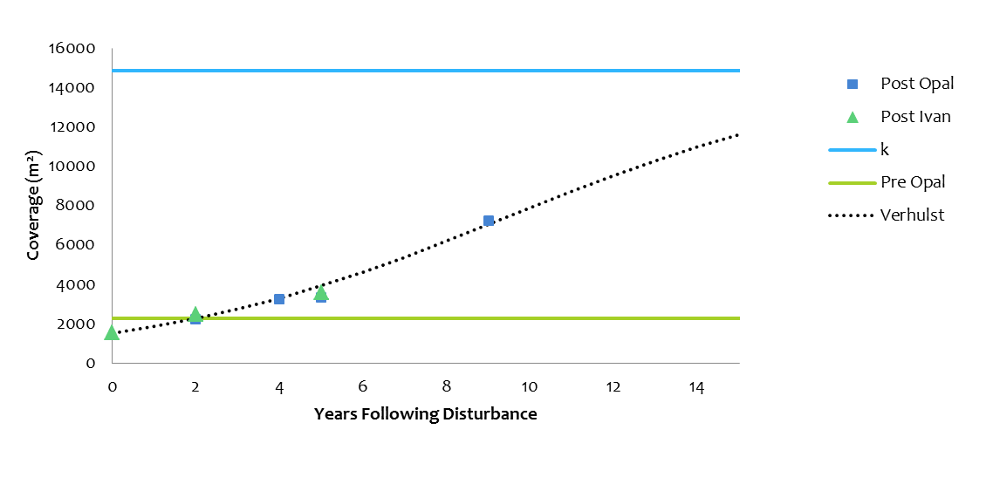
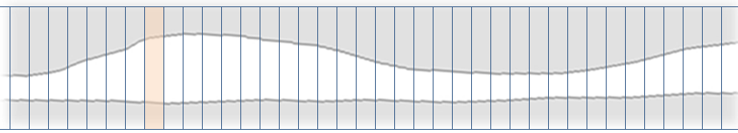
Collision
r² = 0.97
(r) = 0.23
K = 40% of Available Area

Slide 47
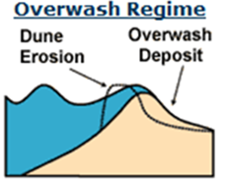
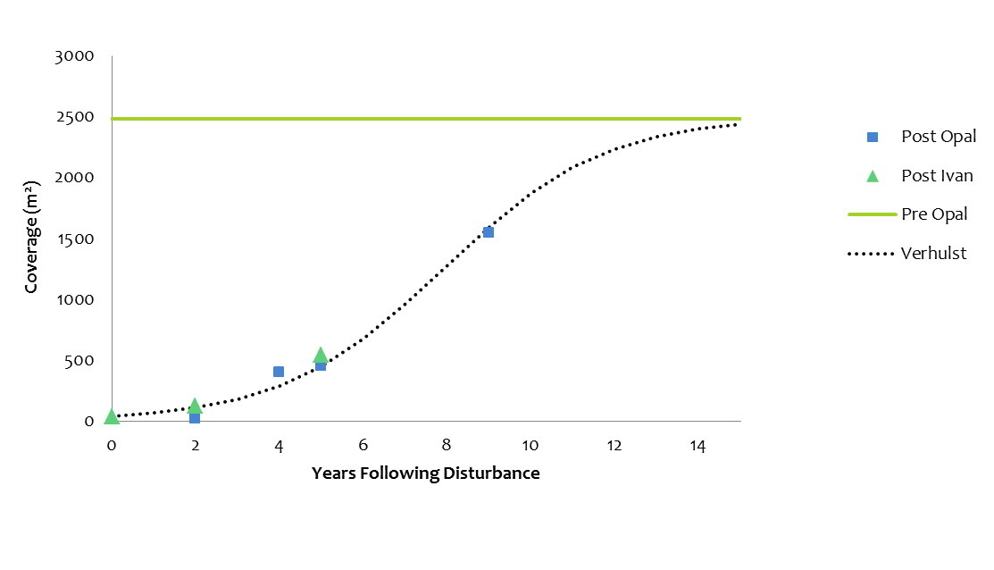
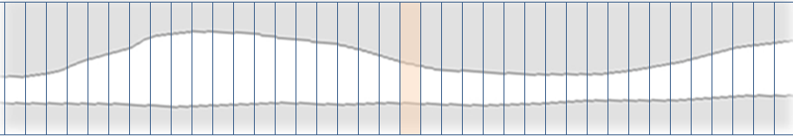
Overwash
R² = 0.98
(r) = 0.52
K = 10% of Available Area

